Slide 1
Term PRESENTATION – Group B
MSDS 7330 – Class 404
SABITRI KC
KIM WONG
RAMYA MANDAVA
CHIRANJEEVI MALLAVARAPU
11/30/2017

Slide 2
Project Abstract
What data you want to collect
We would like to use the international debt public data set from World Bank available at https://cloud.google.com/bigquery/public-data/world-bank-international-debt and also at https://data.worldbank.org/data-catalog/international-debt-statistics
What insights you want to find out. What you want to analyze
We would like to find out which country has the highest debt. Which country has the least debt. And what category of debt is highest across different countries. Does the income level has any effect on the debt level of the country?
What tool? MySQL? XML?, MongoDB
We will be doing this in MySQL on IBM bluemix.

Slide 3
Project Specifications
Data Size (How much MB or GB):
155 MB
Data Source URL:
https://cloud.google.com/bigquery/public-data/world-bank-international-
debt
H/W experimental Specifications (Database server, CPU speed, Memory Size):
MySQL (5.7.19), 1GB

Slide 4
Originality of work
While Google analysis is about Present Value of External Debt (lifetime), we focus on debt outstanding as of Year 2016. This is to ensure we have comparable analysis (on the same terms) and minimize the need to make assumptions on what is the relevant rate to discount specific currency, given country-specific circumstances and changes that may happen over the life of the debt. In addition, 2016 had the most complete data to date for most countries.
We also venture into a new perspective, analyzing metrics such as debts via official creditors vs private non guaranteed, income level of the country and distribution of most owned debt categories. This will expand our understanding of what kind of debt instrument were widely used and what income level have access to such instruments.

Slide 5
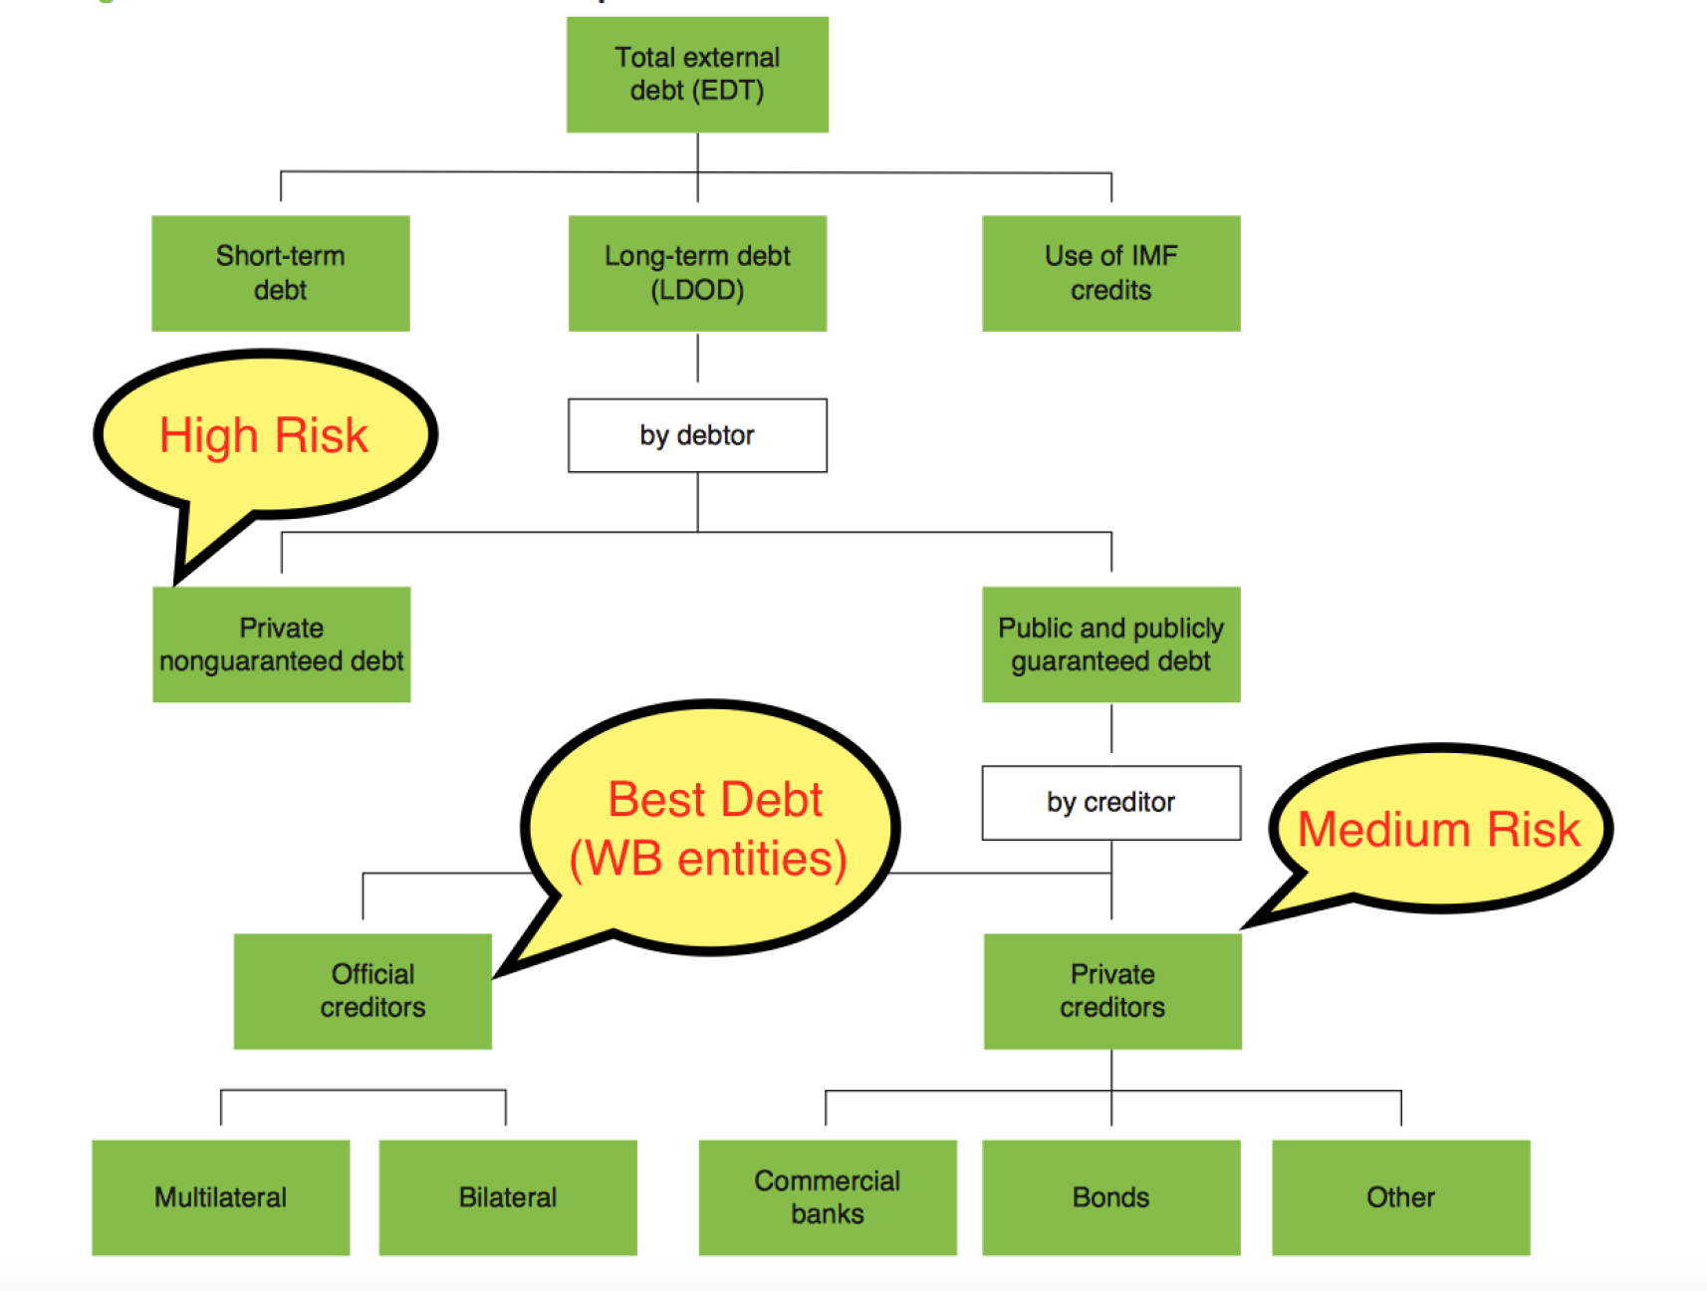
Project Background : Debt classification – Reference item A

Slide 6
Project Deliverables
Which country has the highest debt?
China seems to have the highest external debt^{[1]} i.e.$1430 Billion across
all^{[2]} countries
Which country has the least debt?
Tonga(a Polynesian island) seems to have the lowest external debt^{[1]} i.e.$159.855 Million across all^{[2]} countries
What category of debt is highest across different countries?
On an average long-term external debt seems to be highest across
all^{[2]} countries. Within long-term debt, private non-guaranteed category contributes majorly towards the international debt(49.4%). Official creditors(World Bank entities) contributing least (20%).
[1] External debt comprises of long-term debt, short-term debt, use of IMF credit
[2] The countries in scope for this exercise are only those countries that are developing countries (low and middle-income) and report debt to World bank – excludes USA, Canada, Greenland and some of the european countries

Slide 7
Project Deliverables - Continued
Does the income level has any effect on the debt level of the country?
The average debt of countries with Upper middle income level seems to be
highest(64%) among all the countries and Low income level seems to be the least.
GitHub : https://github.com/skc00/DBMS-Term-Project

Slide 8
References
A) http://databank.worldbank.org/data/download/site-content/IDS-2018.pdf

